Slide 1
Web Programming
Hashing
hashing stored data

Slide 2

The need to hash important stored data
Hashing
Example: if passwords are stored in plain text, e.g.
Could that be a problem?
Yes, it could potentially be read by hackers

Slide 3
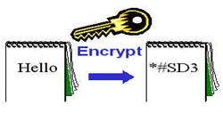
Hashing and the storage of data
Hashing
Use one way hashing algorithms to hash sensitive data such as passwords. Example - CRYPT_BLOWFISH
Examples of php hashing functions
  crypt()
  password_hash()
Example of use - compare user input with that in a database to authenticate passwords
Encrypt important stored data

Slide 4
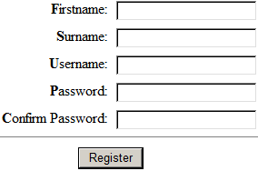
Hashing passwords using password_hash
Hashing
  During user registration we can generate a
  password hash of the password entered by the
  user using the password_hash function, e.g.,
    12tf$t2759#Esz
    could become
    $2y$10$jskbOkCE2LBU5kRRa3CH8uJ2ghk/82mggliuPvxyqH1FDigP6Nvnu
  We can then store the hash in the database rather than the actual password as part of a new user record, e.g.
  Attackers can’t now as easily determine the original password
  Note: the original password is NOT stored anywhere
  NEVER STORE THE ACTUAL PASSWORD IN THE DATABASE

Slide 5
One-way hashing algorithms
Hashing
A one-way hashing algorithm (like those used in password_hash) effectively “scrambles” the password text converting it to a meaningless set of characters
Suitable for use in logon systems as they
  are one-way only, so there is no ‘decryption’ function and therefore the hash can’t be easily ‘reversed’ to reveal the original password if the database is compromised
  should always give the same hash for the same input (and therefore a password ‘attempt’ at logon, when hashed, will produce the same hash as the one stored in the database)
More on logon and password verification later, for now back to password hashing

Slide 6
password_hash()
Hashing
Format: password_hash(string to hash, algorithm [,options])
Algorithms - include
  PASSWORD_DEFAULT, PASSWORD_BCRYPT
Option – cost
Example:
  $option = [
  'cost' => 12,
  ];
  $passwordHash = password_hash($password, PASSWORD_DEFAULT, $option);
The algorithmic
cost
The password that we want to hash
Optional array that can include the cost
The hash produced
The algorithm to use

Slide 7
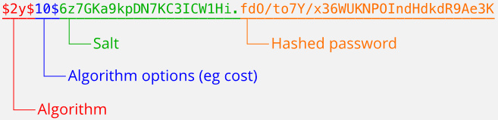
password_hash()
Hashing
The hash returned by the function provides all the information required later to verify the password (during logon), including the algorithm to use
Example:
Source: www.php.net

Slide 8

Verifying logon
Hashing
User enters username and
password in logon form
Query database user table to check
if the entered username exists
User records
If YES
If NO
Retrieve stored hash password
AND then verify entered password against it – see next slide
Ask user to try again

Slide 9
Verifying logon - passwords
Hashing
To verify the password entered by the user in the logon form, check to see if it produces the same hash as the hash stored for the given user
If it does then the entered password must be the same as the correct one. Steps:
Get the password entered in the form
Can use password_verify
to do this
Hash it
Check if hash is the same as the stored hash
If YES
If NO
Grant access
Ask user to try again

Slide 10
Verifying logon – passwords password_verify
Hashing
    if (password_verify($password, $retrievedPasswordHash)) {
    // If the hash of the password we are
    // checking matches the correct hash,
    // do action for correct password
    }
    else {
    // Do action for wrong password
    }
The hash we want to verify against (e.g. one retrieved from db. storage). Ex:
The password to verify (the one entered in the logon form, e.g., 12tf$t2759#Esz)
password_verify extracts the algorithm, cost and salt from the hash we want to verify against and uses them to hash the password entered into the logon form
+ compares the 2 hashes
If an incorrect password is entered, e.g., 45$Qr87$482d, it’s hash
won’t match the correct one

Slide 11
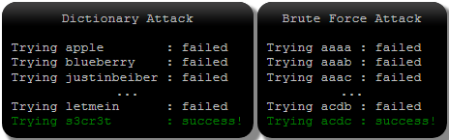

Problem – guessing
Hashing
Problem: if the database is compromised the attacker has the hashed passwords. Doesn’t directly help as you still need the original password to login
However, attacker can try and work out what the original password was by guessing
  Dictionary and brute-force attacks
  Lookup tables

Slide 12
Problem counter measures
Hashing
For dictionary and brute-force attacks
  Enforce long passwords
  Use a strong (and deliberately) slow hash function like password_hash
For lookup tables
  Use a strong hash function like password_hash that automatically adds a long, unique and random salt (a string of say 22 characters) to each password before it is hashed
    A separate one is added per password
    Produces a harder to crack hash as a lookup table would now need to include
      not just each password guess and their hashes, but
      the hash of each password + each possible combination of 22 characters – a much larger table

Slide 13
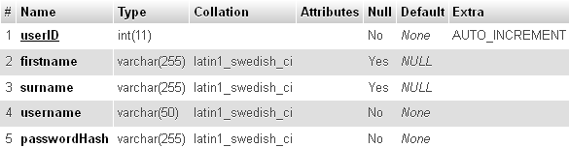

Registration form and database design points
Hashing
Form: don’t overly limit the size of password entry allowed as this can make brute force attacks easier
Database user table for use in registration and logon:
A username and the password hash are required
Make the password field big enough to store the password hash (now and in the future)
Each username needs to be unique

